Slide 1


SIMATS ENGINEERING SAVEETHA INSTITUTE OF MEDICAL AND TECHNICAL SCIENCES CHENNAI -602105
Security Attacks, Threats, Risks and Their Impact on Security Goals
Name : Vempati Murale Karrtik(192312567)
Subject : Cryptography and Network Security
Subject Code : CSA5116
CO1 AT3

Slide 2

Introduction
Information systems are exposed to constant digital danger
Security protects data, systems and networks from misuse
Attacks, threats and risks are related but not the same
Every attack affects one or more core security goals
Understanding them is the first step to defence
Protecting information assets

Slide 3
Security Goals (CIA Triad)
Confidentiality
Integrity
Availability
Only authorised users see data
Encryption, access control
Data stays accurate and unaltered
Hashing, digital signatures
Systems are usable when needed
Backups, redundancy

Slide 4

Security Threats
A threat is a potential danger that may exploit a weakness
Natural: floods, fire, power failure
Human: hackers, insiders, careless users
Technical: malware, software bugs, hardware faults
Threat sources: criminals, hacktivists, nation-states
Threat actors

Slide 5
Types of Security Attacks
Passive Attacks
Active Attacks
Only observe or monitor data
Eavesdropping and traffic analysis
Hard to detect, no data change
Prevented mainly by encryption
Modify, create or disrupt data
Masquerade, replay, modification
Denial of Service (DoS)
Detected and then recovered from

Slide 6

Common Attacks
Malware: virus, worm, trojan, ransomware
Phishing: fake messages steal credentials
Denial of Service: floods a system with requests
Man-in-the-Middle: secretly intercepts traffic
SQL Injection: malicious database queries
Brute force and password attacks
Malicious software

Slide 7
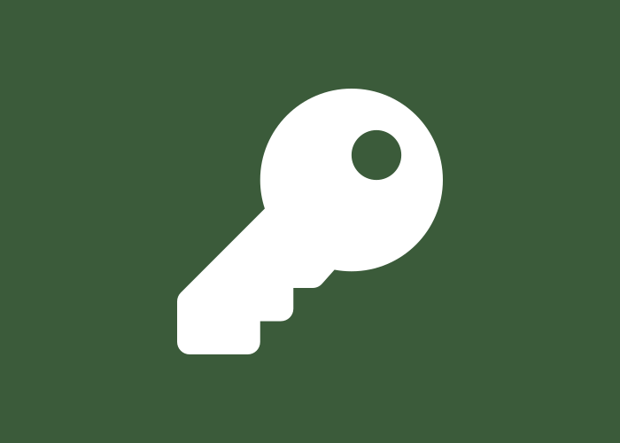
Vulnerabilities and Risks
Vulnerability: a weakness in a system or process
Examples: weak passwords, unpatched software
Risk = Threat x Vulnerability x Impact
High risk: likely threat, easy weakness, big loss
Risk can be reduced, transferred, accepted or avoided
Weak credentials raise risk

Slide 8
Risk Management Process
1
2
3
4
5
Identify assets
Find threats
Assess risk
Apply controls
Monitor
Rank risks by likelihood and impact
Choose controls that fit cost and need
Review regularly as new threats appear

Slide 9
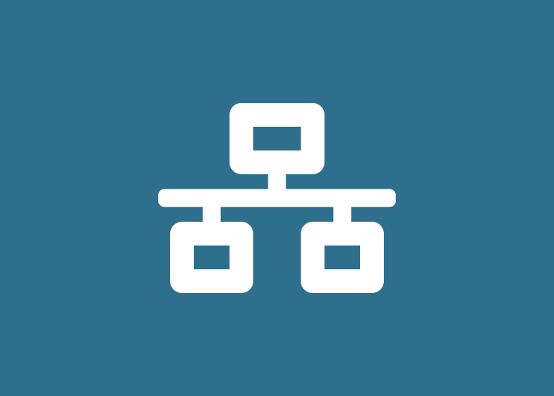
Impact on Confidentiality
Data breach exposes personal and financial data
Caused by eavesdropping, phishing, spyware
Leads to identity theft and privacy loss
Damages trust and brings legal penalties
Defence: encryption, MFA, least privilege
Data travelling over networks

Slide 10
Impact on Integrity and Availability
Integrity
Availability
Data altered or corrupted
Tampering, injection, replay
Wrong decisions and fraud
Use hashing and digital signatures
Services become unreachable
DoS, ransomware, hardware attacks
Lost revenue and productivity
Use backups and redundancy

Slide 11
Attacks Mapped to Security Goals
Attack | Confidentiality | Integrity | Availability
Eavesdropping | High | Low | None
Phishing | High | Medium | Low
Man-in-the-Middle | High | High | Low
Ransomware | Medium | Medium | High
DoS / DDoS | None | None | High

Slide 12
Countermeasures
Firewalls and intrusion detection systems
Strong passwords with multi-factor authentication
Regular patching and updates
Encryption of data at rest and in transit
Backups, security training and incident response
Layered defence

Slide 13
Conclusion
Threats exploit vulnerabilities to create risk
Attacks can be passive or active
Each attack harms confidentiality, integrity or availability
Risk management and layered controls reduce impact
Security is a continuous process, not a one-time task

Slide 14
Thank You

